Slide 1
INTRO to DATA SCIENCE recommendation Engines

Slide 2
I. Data types Ii. Content-based filtering iii. Collaborative filtering exercise: IV. Recommending with python V. The netflix prize
agenda

Slide 3
Recommendation systems
A recommendation system aims to match users to products/items/brand/etc that they likely haven’t experienced yet and/or predict a users preference based on past observations.

Slide 4
Recommendation systems
A recommendation system aims to match users to products/items/brand/etc that they likely haven’t experienced yet and/or predict a users preference based on past observations.
A ranking or prediction is produced by analyzing other user/item ratings (and sometimes item characteristics) to provide personalized recommendations to users.

Slide 5
I. Types of data
INTRO TO DATA SCIENCE

Slide 6
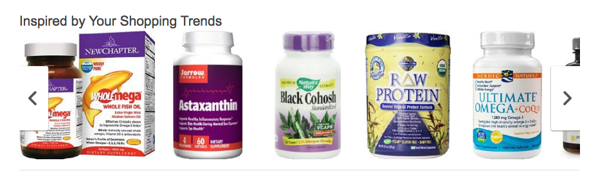
The kind of recommendations you can give, are dependent on the data you have.
Examples – Types of data
Notes:
Implicit feedback; eg browsing behavior (collaborative)

Slide 7

We need data to recommend.
Intro – Types of Data
Preferences Ratings Item meta-data User Behavior

Slide 8
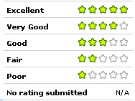
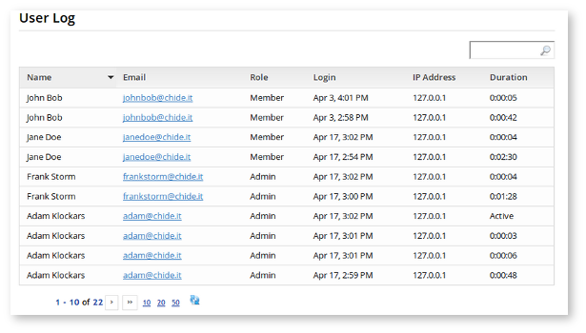
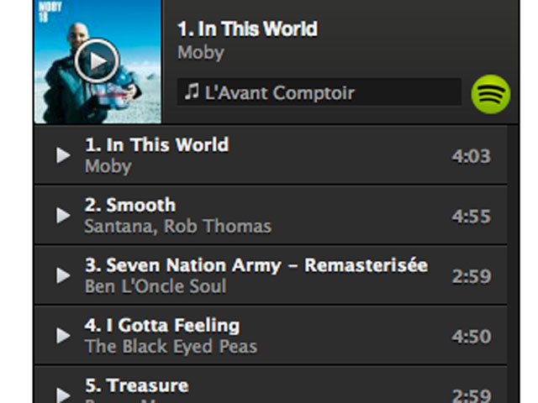
Examples – Types of data
Ratings Upvotes / Downvotes Weighted Scale Grades Relevance Feedback | Access Logs Session Lengths Time spent on a page Clicks / Non-Clicks Purchase History Product Descriptions | Listening History Playlist Creates Follows / Unfriend Impressions Email Reads / Impressions
Notes:
Implicit feedback; eg browsing behavior (collaborative)

Slide 9
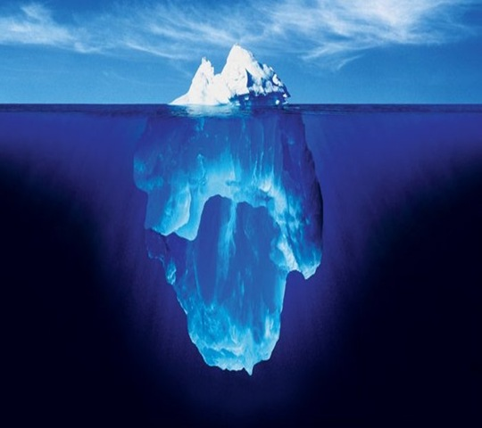
Examples – Types of data
Recommenders need feedback to be useful.

Slide 10
Examples – Types of data
Recommenders need feedback to be useful.
Explicit
Explicit
Explicitly given
Pro-actively acquired
Expensive to collect
Notes:
----- Meeting Notes (2/6/16 22:32) -----
In order to make any recommendations, the system has to collect data. The ultimate goal of collection the data is to get an idea of user preferences, which can later be used to make predictions on future user preferences.

Slide 11
Examples – Types of data
Recommenders need feedback to be useful.
Explicit
Explicit
Explicitly given
Pro-actively acquired
Expensive to collect
Implicit
Implicit
Indirectly given
Larger quantity
Latent qualities

Slide 12
Examples – Types of data
Explicit or Implicit?

Slide 13
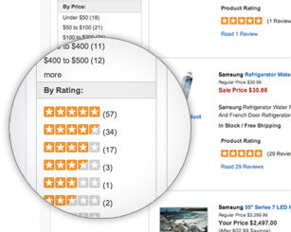
Examples – Types of data
Explicit or Implicit?

Slide 14
Examples – Types of data
Explicit or Implicit?
Ratings: Explicit

Slide 15
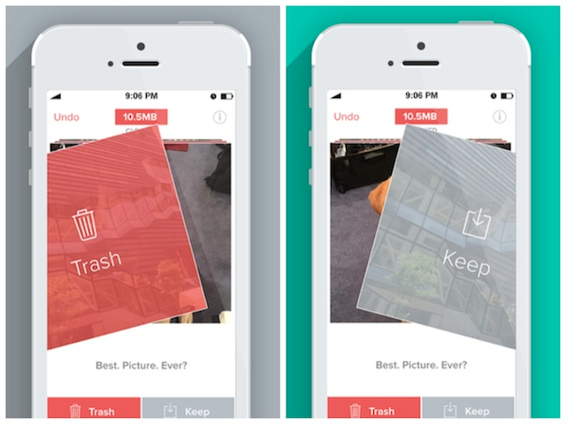
Examples – Types of data
Explicit or Implicit?

Slide 16
Examples – Types of data
Explicit or Implicit?
Swipes: Explicit

Slide 17
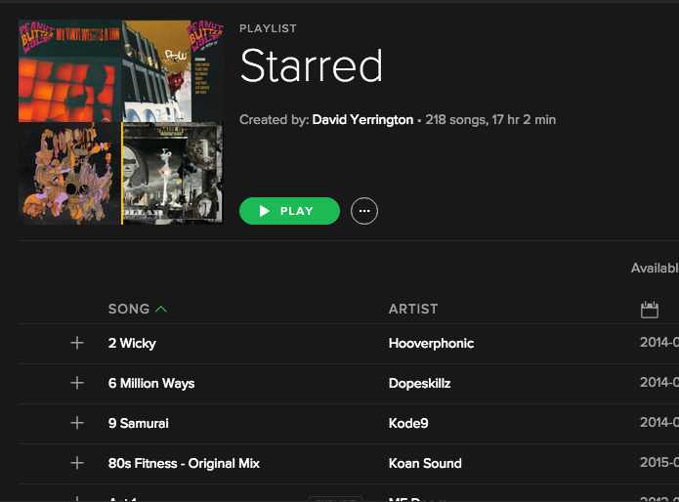
Examples – Types of data
Explicit or Implicit?

Slide 18
Examples – Types of data
Explicit or Implicit?
Both!

Slide 19
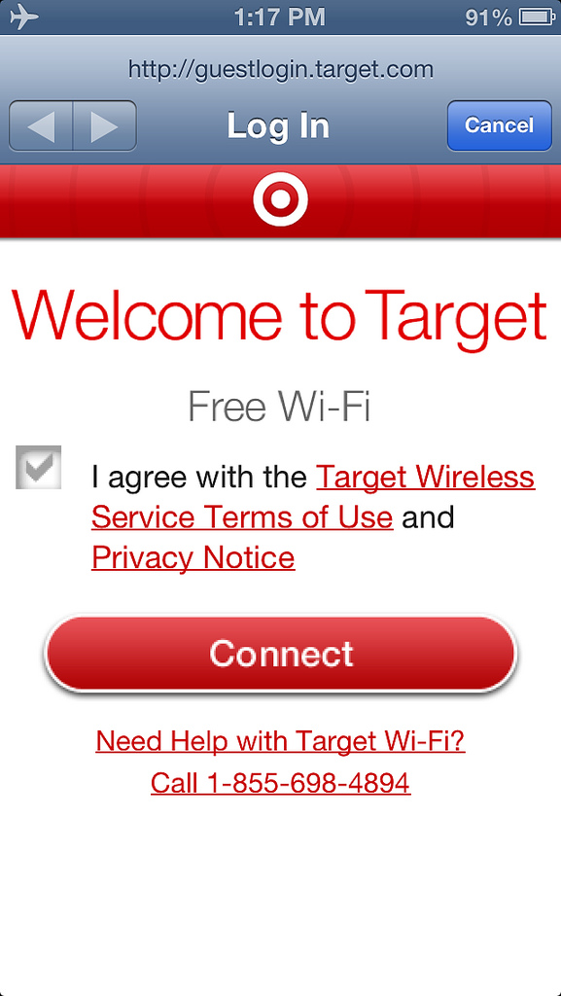
Examples – Types of data
Explicit or Implicit?

Slide 20
Examples – Types of data
Explicit or Implicit?
Wifi logs: Implicit!

Slide 21

Examples – Types of data
Explicit
Ie: Ratings, surveys, reviews
Easy to interpret
Expensive
Explicit
Implicit
Implicit
Ie: Activity logs, clicks, impressions
Hard to interpret
Cheap
NOTE
Implicit data collection can involve some privacy issues; any system that would make recommendations must avoid overstepping its bounds.
Notes:
----- Meeting Notes (2/7/16 18:25) -----
The ultimate goal of collection the data is to get an idea of user preferences, which can later be used to make predictions on future user preferences.
----- Meeting Notes (2/7/16 18:30) -----
Explicit votes may still not be an accurate representation of the true preferences of a user if the person does not know him or herself well enough. Certain studies have shown that people can rate items differently for indiscernible reasons.

Slide 22
Ia. Explicit AND Implicit Feedback
INTRO TO DATA SCIENCE

Slide 23
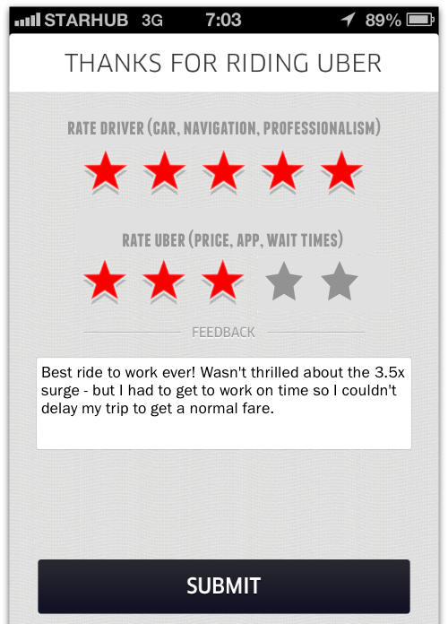
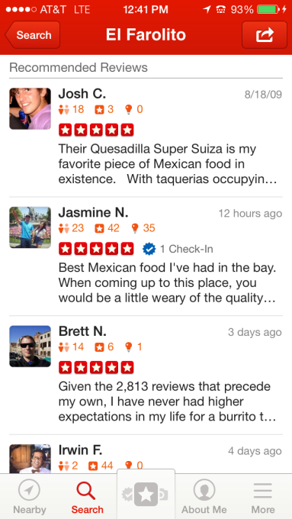

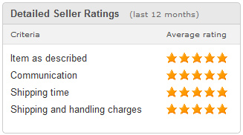
Examples – Types of data
Ratings, Votes, Reviews
Uber Yelp Reddit Ebay
Notes:
----- Meeting Notes (2/7/16 18:25) -----
The ultimate goal of collection the data is to get an idea of user preferences, which can later be used to make predictions on future user preferences.
----- Meeting Notes (2/7/16 18:30) -----
Explicit votes may still not be an accurate representation of the true preferences of a user if the person does not know him or herself well enough. Certain studies have shown that people can rate items differently for indiscernible reasons.

Slide 24
Explicit Data / Feedback - General
Explicit Feedback
Frequently in the form of ratings
Granularly represents preferences
Requires extra effort from the user
Notes:
----- Meeting Notes (2/7/16 19:10) -----
Given the overwhelming amount of items, ratings can be burdensome or inconvenient to collect.

Slide 25
Explicit Data / Feedback - General
Explicit Feedback Questions
What does a rating mean?
Do user preferences change?
Is what is known about the data accurate?
Is what is collected reflect a preference at all?
Is it representative to the goal or only reflective of a singular characteristic?
Notes:
----- Meeting Notes (2/7/16 19:10) -----
Given the overwhelming amount of items, ratings can be burdensome or inconvenient to collect.
----- Meeting Notes (2/7/16 19:24) -----
- Yelp reviews multiple types of businesses. With a singular quality metric. Restaraunts (food, service, location, ambiance) vs locksmith.
- Can you think of any other situations where this may not work well? You might not like speed metal, but then you like it for a week, but then you hate it again.
- When considering ratings, does the same rating reflect well on all items being evaluated?

Slide 26
Explicit Data / Feedback - General
Explicit Feedback - Considerations
Consistent scale for all ratings
Can ratings be skewed by self/selection-bias
Consider the ephemeral nature of preferences
When the data was collected
Before or after experience
Context of presentation
Notes:
----- Meeting Notes (2/7/16 19:10) -----
Given the overwhelming amount of items, ratings can be burdensome or inconvenient to collect.
----- Meeting Notes (2/7/16 19:24) -----
- Yelp reviews multiple types of businesses. With a singular quality metric. Restaraunts (food, service, location, ambiance) vs locksmith.
- Can you think of any other situations where this may not work well? You might not like speed metal, but then you like it for a week, but then you hate it again.
- When considering ratings, does the same rating reflect well on all items being evaluated?
----- Meeting Notes (2/7/16 19:37) -----
People who feel strongly about a topic are more likekly to resond strongly / differently than your general population.
----- Meeting Notes (2/7/16 19:38) -----
Over representing strong positions. Underepresenting indifference.

Slide 27
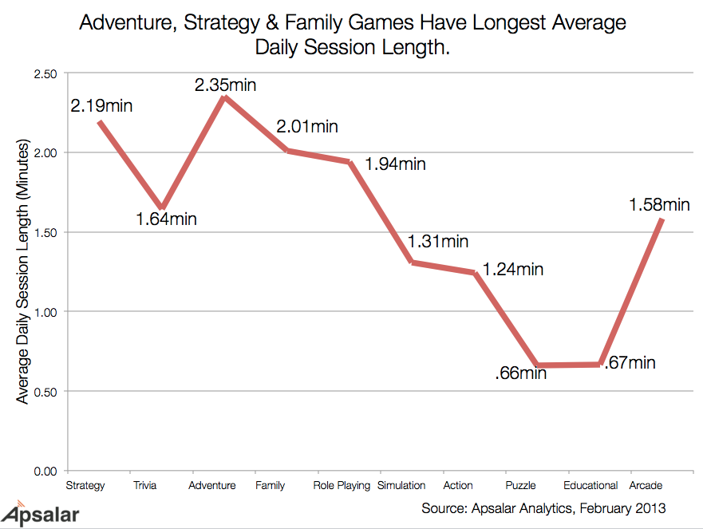
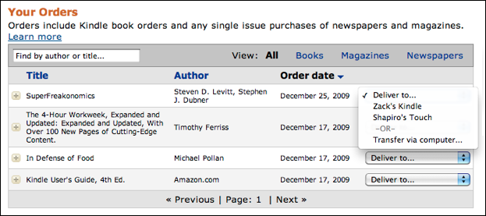
Implicit Data / Feedback - General
Implicit Examples
Order History
Session Length

Slide 28
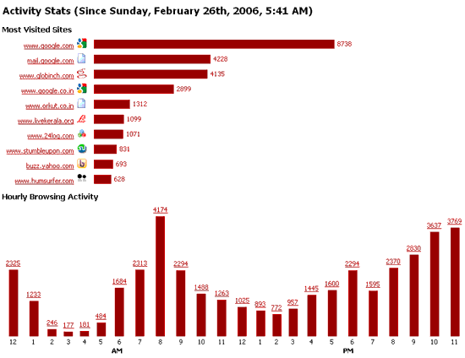
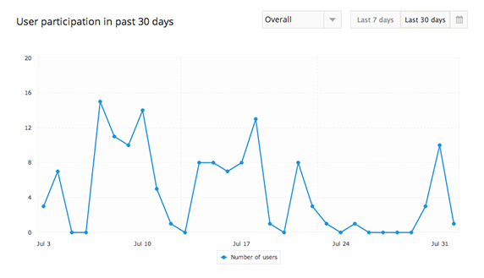
Implicit Data / Feedback - General
Implicit Examples
Engagement Metrics
Session Length

Slide 29
Explicit Data / Feedback - General
Implicit Feedback
It’s still possible to make recommendations when no rating data is explicitly collected from a user. The goal is to convert user behavior into user preferences, but it entails one challenge: How exactly does one infer preference based on actions in a system? This can be a difficult question to answer.
Notes:
----- Meeting Notes (2/7/16 19:10) -----
Given the overwhelming amount of items, ratings can be burdensome or inconvenient to collect.
----- Meeting Notes (2/8/16 00:31) -----
Remember the iceburge?

Slide 30
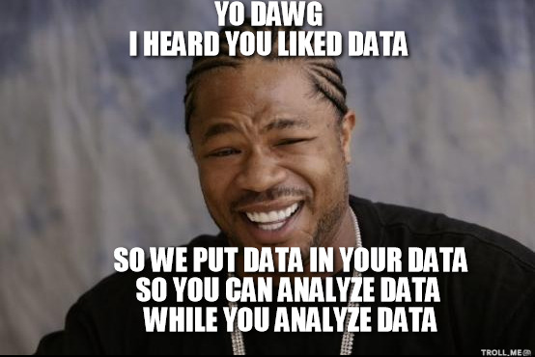
Explicit Data / Feedback - General
Implicit Feedback
There’s tons of it!
Notes:
----- Meeting Notes (2/7/16 19:10) -----
Given the overwhelming amount of items, ratings can be burdensome or inconvenient to collect.
----- Meeting Notes (2/8/16 00:31) -----
Remember the iceburge?

Slide 31
Implicit Data / Feedback - General
Implicit feedback is everywhere.
Email impressions Email click-throughs Conversions Demographic Session lengths Login attempts Track plays Money spent | Ad impressions Ad clicks Ad click-purchase Web “click depth” # of swipes Profile views Message initiations Poll Votes | Friend / unfriend Follow / unfollow *Like Post text Image EXIF Friends in common Message text Food purchases | Geospatial data Store cameras Wifi logins / MAC Time series Objects in photos Driving record Credit history Topics most read
Notes:
----- Meeting Notes (2/8/16 00:31) -----
Is there anything I missed?

Slide 32
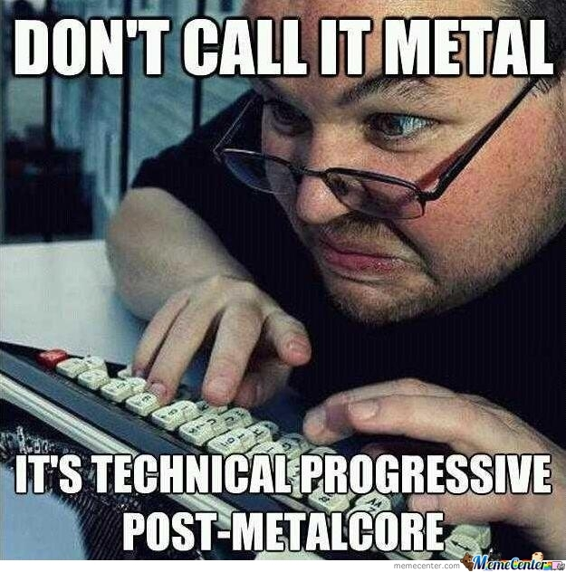
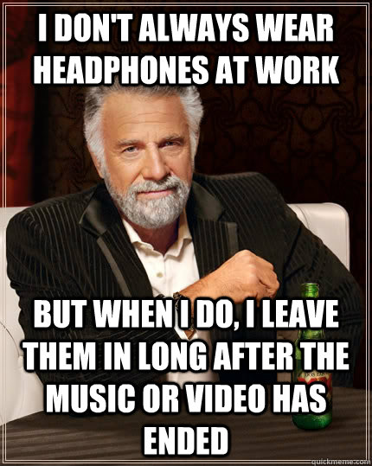
Implicit Data / Feedback - General
Implicit feedback is valuable depending on how you look at it.
?
Notes:
----- Meeting Notes (2/8/16 00:31) -----
Maybe your behavior is deliberate when listening to music, and you have a very clear idea of what you're looking for, or maybe you just put something on in teh background and walk away.
What does the data look like in either of those situations?

Slide 33
Implicit Data / Feedback - General
Implicit Feedback Caveats
Notes:
----- Meeting Notes (2/8/16 00:31) -----
What are some other caveats that you can think of? The big one is they don't tell you what you want to know. They will do whatever they want.

Slide 34
Implicit Data / Feedback - General
Implicit Feedback Caveats (ie: Users don’t tell you what you want to know.)
Preferences can be vague You may need to process tons of data to get what you want Analysis can be complicated / meaning hard to find | Identities can be indistinguishable Users don’t tell you what you want to know Easy to project bias onto data Positive / negative experience hard to assess
Notes:
----- Meeting Notes (2/8/16 00:31) -----
Big picture can be incomplete
You might not have the infrastructure to manage the type of queries to explore your data because it's too big. Sampling can help but only if you know what you're looking for but therein lies the problem. You need big data toolsets to find what you want and pull it back to your instance.

Slide 35
Implicit Data / Feedback - General
Implicit Feedback General Advice:
Question Everything.
Can a preference actually be observed? Is the lack of data actually a negative preference? Is there enough data to describe feedback or only a portion of it? | Is the data scaled properly? Are there hidden correlations? Are there contradictory patterns? What’s missing? Can new features be created?
Notes:
----- Meeting Notes (2/7/16 23:48) -----
Are they just playing music randomly, or are there patterns given other factors like time of day, day of week, holiday?
If your users are buying stuff, do they actually like it?
Because people don't browse your products doesn't mean they don't like them. It could be burried behind bad UI. Perhaps people have a limit attention span and that might inform your evalutation metrics.
Rarely do you get complete pictures with implicit data often you need to analyze it quite a bit in order to find something useful.
Perhaps users behave different when they are at work rather than at home or at different times of day. You might have to filter / munge lots of data to get a sense about what could work.
----- Meeting Notes (2/8/16 00:35) -----
Consider creating new features in your data. For instance -- count the number of first messages someone sends vs total, then over time, then by location, then by length of session. Drill deep and find consistency.

Slide 36
Implicit Data / Feedback - General
Implicit + Explicit Feedback:
Work together
If a user rates an item, can you can use implicit feedback to validate credibility Did they read the article? Do they own the item? Did they rate before or after experience? Do other users mention them? Does user tend to rate high or low? How likely was the rating automated? | Use implicit data to understand the context and characteristics of a rating. Does time of day affect rating? Which kinds of reviews do they typically write? Are the reviews positive or negative? Do other users like their reviews?
Notes:
----- Meeting Notes (2/7/16 23:48) -----
Are they just playing music randomly, or are there patterns given other factors like time of day, day of week, holiday?
If your users are buying stuff, do they actually like it?
Because people don't browse your products doesn't mean they don't like them. It could be burried behind bad UI. Perhaps people have a limit attention span and that might inform your evalutation metrics.
Rarely do you get complete pictures with implicit data often you need to analyze it quite a bit in order to find something useful.
Perhaps users behave different when they are at work rather than at home or at different times of day. You might have to filter / munge lots of data to get a sense about what could work.
----- Meeting Notes (2/8/16 00:35) -----
Consider creating new features in your data. For instance -- count the number of first messages someone sends vs total, then over time, then by location, then by length of session. Drill deep and find consistency.
----- Meeting Notes (2/8/16 01:03) -----
When designing a system, think more than just about models. When you're modeling, think about how to use implicit data to boost the quality of metrics around explicit feedback. Which there are no golden rules. Each industry has their own gold standard when it comes to metrics so subject matter expertise is a must. (emails have a click through rate of 3%. Most new users in mobile apps have a 50% drop off rate. Dating apps have an average churn of 30 days.)

Slide 37

Implicit Data / Feedback - General
Implicit + Explicit Feedback: Final Caveat
Take care when if creating explicit data from implicit data.
Does the set of actions reflect a preference?
Does the scale make sense?
Is the outcome prediction (ratings) or recommendation?
Notes:
----- Meeting Notes (2/7/16 23:48) -----
Are they just playing music randomly, or are there patterns given other factors like time of day, day of week, holiday?
If your users are buying stuff, do they actually like it?
Because people don't browse your products doesn't mean they don't like them. It could be burried behind bad UI. Perhaps people have a limit attention span and that might inform your evalutation metrics.
Rarely do you get complete pictures with implicit data often you need to analyze it quite a bit in order to find something useful.
Perhaps users behave different when they are at work rather than at home or at different times of day. You might have to filter / munge lots of data to get a sense about what could work.
----- Meeting Notes (2/8/16 00:35) -----
Consider creating new features in your data. For instance -- count the number of first messages someone sends vs total, then over time, then by location, then by length of session. Drill deep and find consistency.
----- Meeting Notes (2/8/16 01:03) -----
When designing a system, think more than just about models. When you're modeling, think about how to use implicit data to boost the quality of metrics around explicit feedback. Which there are no golden rules. Each industry has their own gold standard when it comes to metrics so subject matter expertise is a must. (emails have a click through rate of 3%. Most new users in mobile apps have a 50% drop off rate. Dating apps have an average churn of 30 days.)

Slide 38
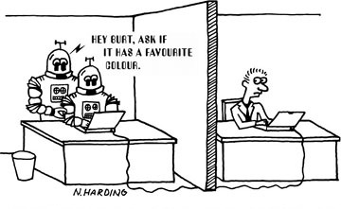
Implicit + Explicit Summary
Explicit Higher value with respect to preferences Usually collected as a “rating” Collection is responsibility of user More direct evaluation of items | Implicit Easy to collect in large quantities More difficult to work with Assumes nothing about the user (could be anyone!) Goal is to convert into preferences
Notes:
----- Meeting Notes (2/7/16 23:48) -----
Are they just playing music randomly, or are there patterns given other factors like time of day, day of week, holiday?
If your users are buying stuff, do they actually like it?
Because people don't browse your products doesn't mean they don't like them. It could be burried behind bad UI. Perhaps people have a limit attention span and that might inform your evalutation metrics.
Rarely do you get complete pictures with implicit data often you need to analyze it quite a bit in order to find something useful.
Perhaps users behave different when they are at work rather than at home or at different times of day. You might have to filter / munge lots of data to get a sense about what could work.
----- Meeting Notes (2/8/16 00:35) -----
Consider creating new features in your data. For instance -- count the number of first messages someone sends vs total, then over time, then by location, then by length of session. Drill deep and find consistency.
----- Meeting Notes (2/8/16 01:03) -----
When designing a system, think more than just about models. When you're modeling, think about how to use implicit data to boost the quality of metrics around explicit feedback. Which there are no golden rules. Each industry has their own gold standard when it comes to metrics so subject matter expertise is a must. (emails have a click through rate of 3%. Most new users in mobile apps have a 50% drop off rate. Dating apps have an average churn of 30 days.)

Slide 39
II. General Design
INTRO TO DATA SCIENCE

Slide 40
Recommendation systems
There are two general approaches to the design:

Slide 41
Recommendation systems
There are many approaches to the design, but these are commonly modeled techniques:
In content-based filtering, items are mapped into a feature space, and recommendations depend on item characteristics.
In contrast, an important assumption underlying all of collaborative filtering, is: users who have similar preferences in the past are likely to have similar preferences in the future.
Notes:
----- Meeting Notes (2/8/16 01:58) -----
It is this assumption which allows us to take a user's history and extrapolate into their future and predict items which they might enjoy.
It's pretty obvious why this can be assumed - we can see that in human nature there are people who are like each other and people who are not. And the people who are like each other tend to, of course, be similar. For recommender systems, we just look at the similarity in their preferences on a particular item.

Slide 42
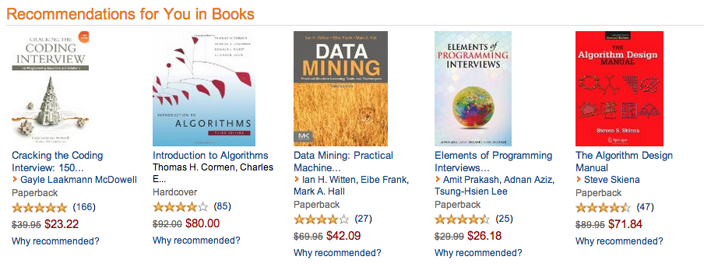
Examples – amazon Content-based
Notes:
Implicit feedback; eg browsing behavior (collaborative)

Slide 43
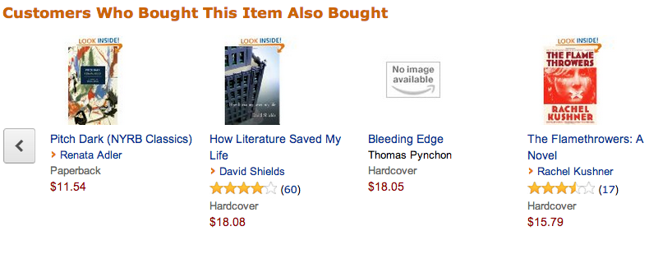
Examples – amazon
Notes:
First & most famous example of item-based CF
----- Meeting Notes (2/8/16 02:00) -----
Is this collaborative or content based?

Slide 44
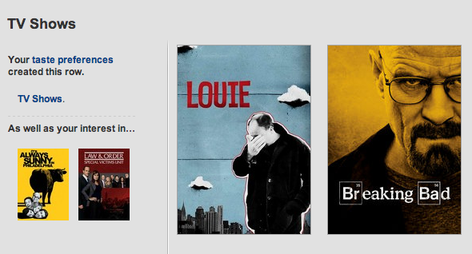
Examples – netflix
Notes:
collaborative

Slide 45
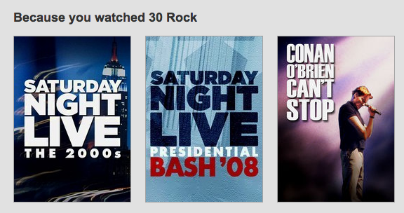
Examples – netflix
Notes:
Item-based

Slide 46
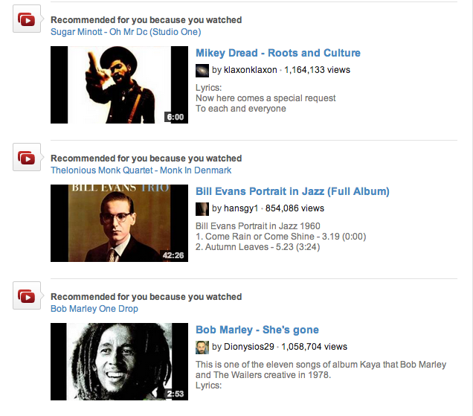
Examples – youtube
Notes:
item-based

Slide 47
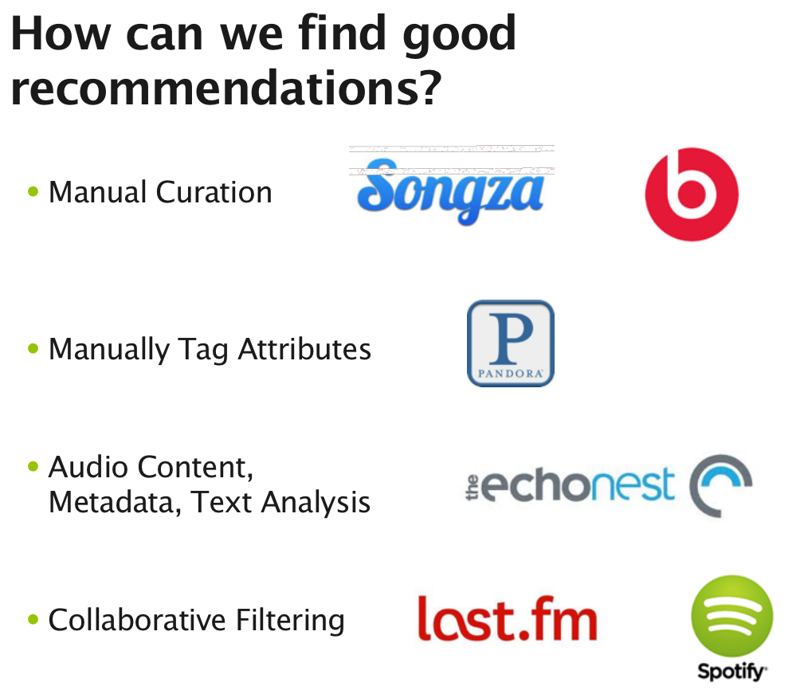
content-based
filtering
Notes:
Content-based

Slide 48
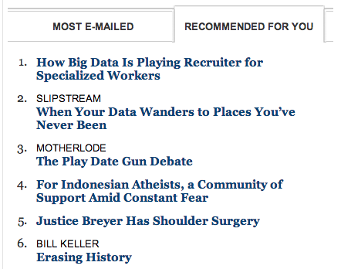
Examples – nytimes.com
Notes:
Content-based

Slide 49
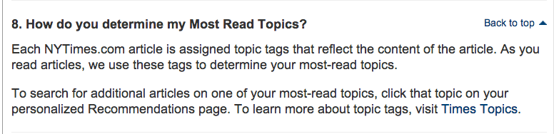
Examples – nytimes.com
NOTE
Collaborative or Content based?
Notes:
Content-based

Slide 50
Examples – nytimes.com
NOTE
Collaborative or Content based?
CONTENT BASED ☺
Notes:
Content-based

Slide 51
I. content-based filtering
INTRO TO DATA SCIENCE

Slide 52
Content-based filtering
Content-based filtering begins by mapping each item into a feature space. Both users and items are represented by vectors in this space.

Slide 53
Content-based filtering
Content-based filtering begins by mapping each item into a feature space. Both users and items are represented by vectors in this space.
Item vectors measure the degree to which the item is described by each feature, and user vectors measure a user’s preferences for each feature.

Slide 54
Content-based filtering
Content-based filtering begins by mapping each item into a feature space. Both users and items are represented by vectors in this space.
Item vectors measure the degree to which the item is described by each feature, and user vectors measure a user’s preferences for each feature.
Ratings are generated by taking dot products of user & item vectors.

Slide 55
Example – content-based filtering
features = (big box office, aimed at kids, famous actors)
Items (movies):
Finding Nemo = (5, 5, 2)
Mission Impossible = (3, -5, 5)
Jiro Dreams of Sushi = (-4, -5, -5)

Slide 56
Example – content-based filtering
features = (big box office, aimed at kids, famous actors)
Items (movies):
Finding Nemo = (5, 5, 2)
Mission Impossible = (3, -5, 5)
Jiro Dreams of Sushi = (-4, -5, -5)
Users:
Alice = (-3, 2, -2)
Bob = (4, -3, 5)

Slide 57
Example – content-based filtering
features = (big box office, aimed at kids, famous actors)
Items (movies): Prediction (for Alice)
Finding Nemo = (5, 5, 2) 5*-3 + 5*2 + 2*-2 = -9
Mission Impossible = (3, -5, 5)
Jiro Dreams of Sushi = (-4, -5, -5)
User:
Alice = (-3, 2, -2)

Slide 58
Example – content-based filtering
features = (big box office, aimed at kids, famous actors)
Items (movies): Prediction (for Alice)
Finding Nemo = (5, 5, 2) 5*-3 + 5*2 + 2*-2 = -9
Mission Impossible = (3, -5, 5) 3*-3 + -5*2 + 5*-2 = -29
Jiro Dreams of Sushi = (-4, -5, -5)
User:
Alice = (-3, 2, -2)

Slide 59
Example – content-based filtering
features = (big box office, aimed at kids, famous actors)
Items (movies): Prediction (for Alice)
Finding Nemo = (5, 5, 2) 5*-3 + 5*2 + 2*-2 = -9
Mission Impossible = (3, -5, 5) 3*-3 + -5*2 + 5*-2 = -29
Jiro Dreams of Sushi = (-4, -5, -5) -4*-3 + -5*2 + -5*-2 = +12
User:
Alice = (-3, 2, -2)

Slide 60

Example – content-based filtering
features = (big box office, aimed at kids, famous actors)
Items (movies): Prediction (for Alice)
Finding Nemo = (5, 5, 2) 5*-3 + 5*2 + 2*-2 = -9
Mission Impossible = (3, -5, 5) 3*-3 + -5*2 + 5*-2 = -29
Jiro Dreams of Sushi = (-4, -5, -5) -4*-3 + -5*2 + -5*-2 = +12
User:
Alice = (-3, 2, -2)

Slide 61
Example – content-based filtering
features = (big box office, aimed at kids, famous actors)
Items (movies): Prediction (for Bob)
Finding Nemo = (5, 5, 2)
Mission Impossible = (3, -5, 5)
Jiro Dreams of Sushi = (-4, -5, -5)
User:
Bob = (4, -3, 5)

Slide 62
Example – content-based filtering
features = (big box office, aimed at kids, famous actors)
Items (movies): Prediction (for Bob)
Finding Nemo = (5, 5, 2) 5*4 + 5*-3 + 2*5 = +15
Mission Impossible = (3, -5, 5) 3*4 + -5*-3 + 5*5 = +52
Jiro Dreams of Sushi = (-4, -5, -5) -4*4 + -5*-3 + -5*5 = -26
User:
Bob = (4, -3, 5)

Slide 63

Example – content-based filtering
features = (big box office, aimed at kids, famous actors)
Items (movies): Prediction (for Bob)
Finding Nemo = (5, 5, 2) 5*4 + 5*-3 + 2*5 = +15
Mission Impossible = (3, -5, 5) 3*4 + -5*-3 + 5*5 = +52
Jiro Dreams of Sushi = (-4, -5, -5) -4*4 + -5*-3 + -5*5 = -26
User:
Bob = (4, -3, 5)

Slide 64
content-based filtering
One notable example of content-based filtering is Pandora, which maps songs into a feature space using features (or “genes”) designed by the Music Genome Project.
Using song vectors that depend on these features, Pandora can create a station with music having similar properties to a song the user selects.

Slide 65
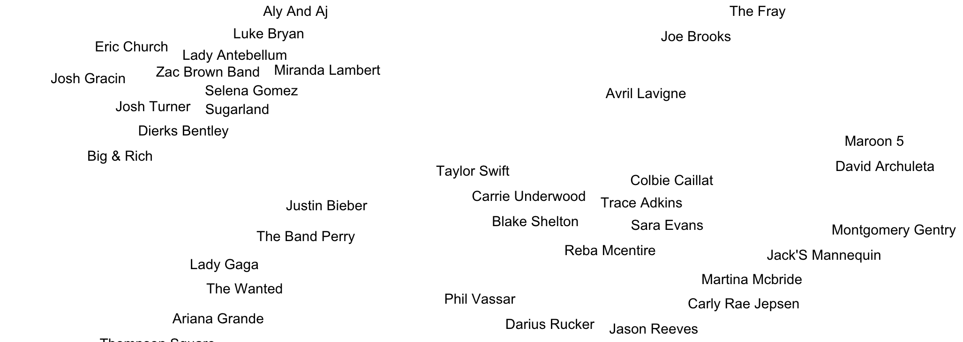
Visualization of similar artists
http://www.music-map.com/

Slide 66
content-based filtering
Content-based filtering has some difficulties:

Slide 67
content-based filtering
Content-based filtering has some difficulties:
Must map items into a feature space (usually by hand!)
Recommendations are limited in scope (items must be similar to each other)
Hard to create cross-content recommendations (eg books/music films…this would require comparing elements from different feature spaces!)

Slide 68
II. collaborative filtering
INTRO TO DATA SCIENCE

Slide 69
Collaborative filtering
Collaborative filtering refers to a family of methods for predicting ratings where instead of thinking about users and items in terms of a feature space, we are only interested in the existing user-item ratings themselves.

Slide 70
Collaborative filtering
Collaborative filtering refers to a family of methods for predicting ratings where instead of thinking about users and items in terms of a feature space, we are only interested in the existing user-item ratings themselves.
In this case, our dataset is a ratings matrix whose columns correspond to items, and whose rows correspond to users.

Slide 71
Collaborative filtering
Collaborative filtering refers to a family of methods for predicting ratings where instead of thinking about users and items in terms of a feature space, we are only interested in the existing user-item ratings themselves.
In this case, our dataset is a ratings matrix whose columns correspond to items, and whose rows correspond to users.
NOTE
The idea here is that users get value from recommendations based on other users with similar tastes.

Slide 72
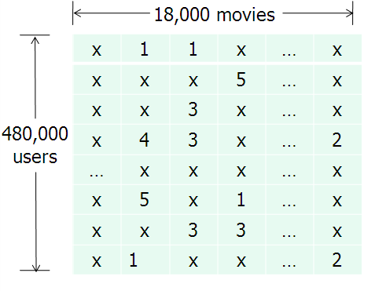
Ratings matrix
NOTE
This matrix will always be sparse!
source: http://www.eecs.berkeley.edu/~zhanghao/main/publications/subfolder/netflix.png

Slide 73
Collaborative filtering
Main difference between content and collaborative filtering:
Content Based:
maps items and users into a feature space
Collaborative:
relies on previous user-item ratings

Slide 74
Collaborative filtering
We will look at collaborative filtering in a user-user sense.

Slide 75
Collaborative filtering
We will look at collaborative filtering in a user-user sense.
We will take a given user, and find the K most similar users, and then recommend brands from the similar users!

Slide 76
Collaborative filtering
We will look at collaborative filtering in a user-user sense.
We will take a given user, and find the K most similar users, and then recommend brands from the similar users!
NOTE
Sound familiar? It’s similar to KNN!

Slide 77
Item-based collaborative filtering
Notes:
First & most famous example of item-based CF

Slide 78
Cold start problem
The system cannot draw inferences because it hasn’t gathered enough information yet.

Slide 79
Cold start problem
The cold start problem arises because we’ve been relying only on ratings data, or on explicit feedback from users.

Slide 80
Cold start problem
The cold start problem arises because we’ve been relying only on ratings data, or on explicit feedback from users.
Until users rate several items, we don’t know anything about their preferences!

Slide 81
Cold start problem
The cold start problem arises because we’ve been relying only on ratings data, or on explicit feedback from users.
Until users rate several items, we don’t know anything about their preferences!
We can get around this by enhancing our recommendations using implicit feedback, which may include things like item browsing behavior, search patterns, purchase history, etc.

Slide 82
Cold start problem
While explicit feedback (ratings, likes, purchases) leads to high quality ratings, the data is sparse and cold starts are problematic.

Slide 83
Cold start problem
While explicit feedback (ratings, likes, purchases) leads to high quality ratings, the data is sparse and cold starts are problematic.
Meanwhile implicit feedback (browsing behavior, etc.) leads to less accurate ratings, but the data is much more dense (and less invasive to collect).

Slide 84
III. Python example
INTRO TO DATA SCIENCE

Slide 85
Python exercise
Our data:
CSV of two columns, user ID and Brand
Each row represents a user liking a brand

Slide 86
Python exercise
Example:
User ID | Brand
86509 | H&M
86509 | Target
86509 | Old Navy
86510 | H&M
86510 | Lowe’s
86510 | Home Depot
86511 | Banana Republic
86511 | Kohl’s
86511 | Old Navy

Slide 87
Python exercise
How do we define “similarity” of users?

Slide 88
Python exercise
How do we define “similarity” of users?
This is required if we want to do user-based collaborative filtering

Slide 89

Python exercise
MATH ALERT!!

Slide 90
Python exercise
How do we define “similarity” of users?
Jaccard Similarity:
Defines similarity between two sets of objects

Slide 91
Python exercise
How do we define “similarity” of users?
Jaccard Similarity:
Defines similarity between two sets of objects

Slide 92
Python exercise
How do we define “similarity” of users?
Jaccard Similarity:
Defines similarity between two sets of objects
Number of similar elements
Number of distinct elements

Slide 93
Python exercise
JS ({1, 2, 3}, {2,3,4}) = {2, 3} 2
------ = ----
{1, 2, 3, 4} 4

Slide 94
Python exercise
Exercise:
User one: {“Target”, “Banana Republic”, “Old Navy”}
User two: {“Banana Republic”, “Gap”, “Kohl’s”}
JS (User one, User two) =

Slide 95
Python exercise
Exercise:
User one: {“Target”, “Banana Republic”, “Old Navy”}
User two: {“Banana Republic”, “Gap”, “Kohl’s”}
JS (User one, User two) = 1 / 5 = .2

Slide 96
Python algorithm steps
Get list of known users in a dictionary where the key is the user ID, an the value is a list of brands they like
Example: { ‘83065’ : ["Kohl's", 'Target’] }
For a given user, we will calculate their closeness to every user in csv
We will choose the K most similar users
Recommend brands liked by similar users

Slide 97
Python algorithm steps
Get list of known users in a dictionary where the key is the user ID, an the value is a list of brands they like
Example: { ‘83065’ : ["Kohl's", 'Target’] }
For a given user, we will calculate their closeness to every user in csv
We will choose the K most similar users
Recommend brands liked by similar users
Consider this a kind of KNN but instead of Euclidean Distance, we are using the Jaccard Similarity

Slide 98
IV. The netflix prize
INTRO TO DATA SCIENCE

Slide 99
The netflix prize
The Netflix prize was a competition to see if anyone could make a 10% improvement to Netflix’s recommendation system (accuracy measured by RMSE).

Slide 100
The netflix prize
The Netflix prize was a competition to see if anyone could make a 10% improvement to Netflix’s recommendation system (accuracy measured by RMSE).
The grand prize was $1m dollars

Slide 101
The netflix prize
The Netflix prize was a competition to see if anyone could make a 10% improvement to Netflix’s recommendation system (accuracy measured by RMSE).
The grand prize was $1m dollars
The ratings matrix contained >100mm numerical entries (1-5 stars) from ~500k users across ~17k movies. The data was split into train/quiz/test sets to prevent overfitting on the test data by answer submission (this was a clever idea!)

Slide 102
The netflix prize
The competition began in 2006, and the grand prize was eventually awarded in 2009. The winning entry was a stacked ensemble of 100’s of models (including neighborhood & matrix factorization models) that were blended using boosted decision trees.
Ultimately, the competition ended in a photo finish. The winning strategy came down to last-minute team mergers & creative blending schemes to shave 3rd & 4th decimals off RMSE (concerns that would not be important in practice).

Slide 103
The netflix prize
The competition began in 2006, and the grand prize was eventually awarded in 2009. The winning entry was a stacked ensemble of 100’s of models (including neighborhood & matrix factorization models) that were blended using boosted decision trees.
Ultimately, the competition ended in a photo finish. The winning strategy came down to last-minute team mergers & creative blending schemes to shave 3rd & 4th decimals off RMSE (concerns that would not be important in practice).
The competition did much to spur interest and research advances in recsys technology, and the prize money was donated to charity.
Notes:
http://www.techdirt.com/blog/innovation/articles/20120409/03412518422/why-netflix-never-implemented-algorithm-that-won-netflix-1-million-challenge.shtml

Slide 104
The netflix prize
Though they adopted some of the modeling techniques that emerged from the competition, Netflix never actually implemented the prizewinning solution.
Why do you think that’s true?
Notes:
http://techblog.netflix.com/2012/04/netflix-recommendations-beyond-5-stars.html

